Slide 1
CSE455 - Software Testing
Chapter 1

Slide 2
Course outline
Introduction
Software testing basics
Testing throughout the software development life cycle
Static Testing
Dynamic Testing
Test Management
Testing tools

Slide 3
High dependency on software system
Software is everywhere! Nowadays there are virtually no devices, machines, or systems that are not partially or entirely controlled by software.

Slide 4
High dependency on software system
Software is everywhere! Nowadays there are virtually no devices, machines, or systems that are not partially or entirely controlled by software.
Software and software quality therefore not only govern how large parts of our lives function, they are also increasingly important factors in our everyday safety.

Slide 5
High dependency on software system
Software is everywhere! Nowadays there are virtually no devices, machines, or systems that are not partially or entirely controlled by software.
Software and software quality therefore not only govern how large parts of our lives function, they are also increasingly important factors in our everyday safety.
Smooth functioning of countless companies relies on reliability of software systems.

Slide 6
Importance of Testing
Quality is crucial factor for the success of product

Slide 7
Importance of Testing
Quality is crucial factor for the success of product
Introduction of software evaluation and testing procedures are required

Slide 8
Importance of Testing
Quality is crucial factor for the success of product
Introduction of software evaluation and testing procedures are required
Improve overall software quality

Slide 9
Certifications in Software Testing
ISTQB (International Software Testing Qualifications Board) coordinates qualification activities in individual countries and ensures the global consistency and comparability of the syllabi and exam papers

Slide 10
Certifications in Software Testing
ISTQB (International Software Testing Qualifications Board) coordinates qualification activities in individual countries and ensures the global consistency and comparability of the syllabi and exam papers
National Testing Boards are responsible for publishing and maintaining local content as well as the organization and supervision of exams

Slide 11
Certifications in Software Testing
ISTQB (International Software Testing Qualifications Board) coordinates qualification activities in individual countries and ensures the global consistency and comparability of the syllabi and exam papers
National Testing Boards are responsible for publishing and maintaining local content as well as the organization and supervision of exams
Basics of Software Testing are covered in Foundation Level, you can further move to Advance Level exam, which offers deep understanding of evaluation and testing techniques. The Expert Level certificate is aimed at experienced software testing professionals.

Slide 12
Case Study: VirtualShowRoom VSR-II
Electronic sales system managed by a car manufacturer
Five modules
DreamCar: Customers can configure their vehicle ( model, color, extras, and so on) and calculate price
EasyFinance: for optimal financing
JustInTime: to order the vehicle
NoRisk: Select insurance
FactBook: manages all customer and contract data

Slide 13
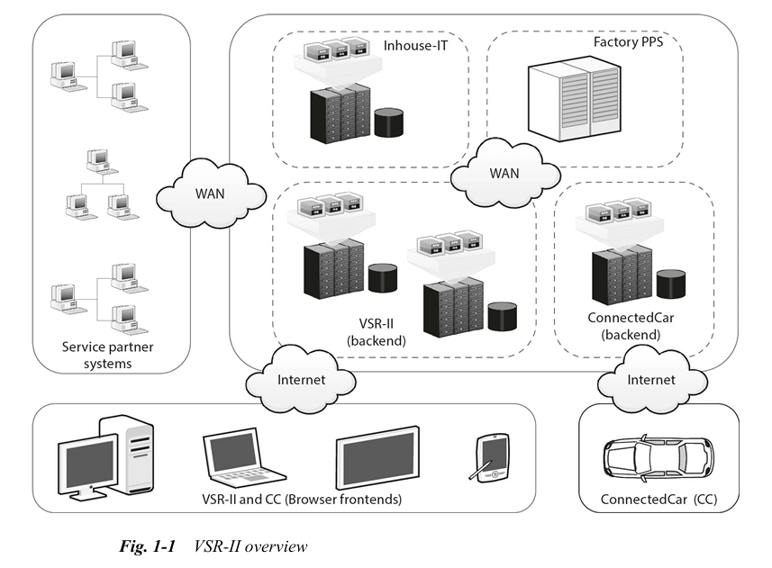

Slide 14
Cont.
The manufacturer’s sales and marketing department has decided to update the system and has defined the following objectives

Slide 15
Cont.
The manufacturer’s sales and marketing department has decided to update the system and has defined the following objectives
VSR is a traditional client-server system. The new VSR-II will be web based and will be accessible on all types of devices
The DreamCar, EasyFinance, FactBook, JustInTime, and NoRisk modules will be ported to the new technology

Slide 16
Cont.
The new ConnectedCar module is to be integrated into the system. This module collects and manages status data for all vehicles sold, and communicates data relating to scheduled maintenance and repairs to the driver as well as to the dealership and/or service partner.

Slide 17
Cont.
The new ConnectedCar module is to be integrated into the system. This module collects and manages status data for all vehicles sold, and communicates data relating to scheduled maintenance and repairs to the driver as well as to the dealership and/or service partner.
Each of the five existing modules will be ported and developed by a dedicated team. An additional team will develop the new ConnectedCar module. The project employs a total of 60 developers and other specialists from internal company departments as well as a number of external software companies.

Slide 18
Cont.
The teams will work using the Scrum principles of agile development. This agile approach requires each module to be tested during each iteration. The system is to be delivered incrementally.

Slide 19
Cont.
The teams will work using the Scrum principles of agile development. This agile approach requires each module to be tested during each iteration. The system is to be delivered incrementally.
In order to avoid complex repeat data comparisons between the old and new systems, VSR-II will only go live once it is able to duplicate the functionality provided by the original VSR system

Slide 20
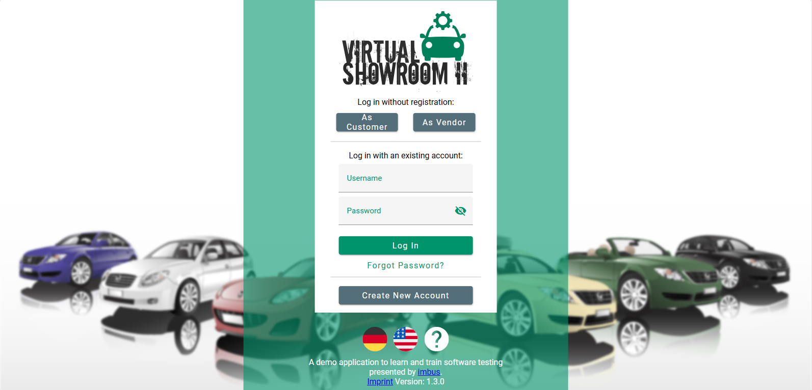
Cont.
Visit http://vsr.testbench.com/
Create your personal VSR-II training workspace
Log into your VSR-II workspace and start

Slide 21
Conclusion
Testing ensures software reliability and quality
Different certifications at 3 stages are available
VSR is a suitable platform for software testing

